Slide 1

Complexity Theory
Lecture 1,2
1

Slide 2
Introduction to Complexity Theory
▪
“Complexity theory” is the body of knowledge concerning fundamental principles of computation. Its beginnings can be traced way back in history to the use of asymptotic complexity and reducibility by the Babylonians.
Complexity theory is concerned with the resources, such as time and space, needed to solve computational problems. After the success of the general theory of computability, that gave us a precise definition of the notion of algorithm and fundamental insights into the notion of mathematical proof and undecidability, it was only natural to also consider the notion of efficient computation, and ask why some problems that are computable in principle resist all attempts to compute them in a reasonable amount of time.
There is an abundance of problems from mathematics and computer science that are trivially solvable by brute force search of an exponential number of instances, but for which currently no efficient algorithm is known. Complexity theory is the appropriate setting for the study of such problems.
It is also the home of one of the most fundamental open problems in mathematics, namely the famous NP versus P problem. Some 40 years after the discovery of this problem, complexity theory has matured into an extremely rich and fascinating subject, despite the lack of progress on some of its most fundamental problems.
▪
▪
▪
2

Slide 3
Theory of Computation
The theory of computation studies
  whether (computability theory), and
  how efficiently (complexity theory)
certain problems can be solved on a computer, or rather on a model of a computer.
Several equivalent models of computational devices can be used:
  Register machines.
  Lambda calculus.
  Simple while programming language (pseudo-code).
  Turing machines. ...
We focus on Turing machines.

Slide 4
Computability
Do algorithmic solutions to problems always exist?
What are the limitations of computational devices?
Is there any insight to which problems are algorithmically solvable and which are not?
Are the unsolvable problems somehow related?
Complexity
How do we compare the efficiency of different algorithms?
How do we measure time/memory requirements?
What problems are efficiently solvable?
Are there solvable problems which do not have efficient algorithms?

Slide 5
Alphabets Σ
Formal Languages
An alphabet is any finite set of symbols.
Examples: ASCII, Unicode, {0,1} (binary alphabet ), {a,b,c}.
A string or word |w|
The set of strings over an alphabet Σ is the set of lists, each element of which is a member of Σ.
  Strings shown with no commas, e.g., abc.
Σ* denotes this set of strings.
ε stands for the empty string (string of length 0).

Slide 6
Languages L
A language is a subset of Σ* for some alphabet Σ.
Example: The set of strings of 0’s and 1’s with no two consecutive 1’s.
L = {ε, 0, 1, 00, 01, 10, 000, 001, 010, 100, 101, 0000, 0001, 0010, 0100, 0101, 1000, 1001, 1010, . . . }
Operations on Languages
Let L1 and L2 be two languages (L1, L2 ⊆ Σ ∗ ).
L1 ∪ L2 = {w ∈ Σ ∗ | w ∈ L1 or w ∈ L2}
L1 ∩ L2 = {w ∈ Σ ∗ | w ∈ L1 and w ∈ L2}
L1 = {w ∈ Σ ∗ | w 6∈ L1}
L1.L2 = {w ∈ Σ ∗ | w = w1w2 where w1 ∈ L1 and w2 ∈ L2}
L ∗ 1 = {w ∈ Σ ∗ | w = w1w2 . . .wk where k ≥ 0 and each wi ∈ L1 for all 1 ≤ i ≤ k}

Slide 7
Turing Machine
▪
So far in our development of theory of computation we have presented several models for computing devices
Finite automata are good models for devices that have a small amount of memory.
Pushdown automata are good models for devices that have an unlimited memory that is usable only in the last in, first out manner of a stack.
We have shown that some very simple tasks are beyond the capabilities of these models.
Now we will consider a much more powerful model, first proposed by Alan Turing in 1936, called the Turing Machine (TM).
▪
▪
▪
▪
7

Slide 8
▪
A Turing Machine (TM) is a mathematical model which consists of an infinite length tape divided into cells on which input is given.
It consists of a head which reads the input tape. A state register stores the state of the Turing machine. After reading an input symbol, it is replaced with another symbol, its internal state is changed, and it moves from one cell to the right or left. If the TM reaches the final state, the input string is accepted, otherwise rejected.
The purpose of the theory of Turing machines is to prove that certain specific languages have no algorithm.
▪
The Turing machine model uses an infinite tape as its unlimited memory.
✓
✓
✓
✓
✓
✓
It has a head that can read and write symbols and move around on the tape. Initially the tape contains only the input string and is blank everywhere else. If TM needs to store information, it may write this info on the tape.
To read the information that it has written, TM can move its head back over it. The machine continues computing until it produces an output.
rejecting halting.
The output accept and reject are obtained by entering designated accepting and
states.
✓
If it does not enter an accepting or a rejecting state, it will go on forever, never
8

Slide 9
Formal Definition of TMs
TM can be formally described as a 7-tuple
(Q, Σ, Γ, 𝛿 , q₀ , q_{accept}, q_{reject})
Q
is a finite set of states,
is a finite input alphabet not containing
Σ
Γ
is a finite tape alphabet, such that
∈,   ,
^{𝛿 :}Q × Γ → Q × Γ × {L, R} is the transition function,
q₀ ∈ Q
is the start state or initial state,
^{qf (qaccept , qreject ∈ Q)} is the accept state, and is the reject state, where ^{q}accept ^{q}reject .
b
blank symbol
read-write head
infinite tape
control
Schematic of a Turing Machine:
a | a | b | b |  |  |  |  |  | …
9

Slide 10
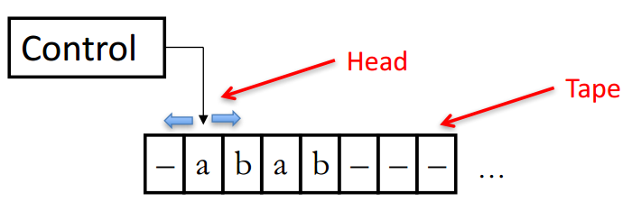
The control operates as a state machine
Starts in an initial state
Proceeds in a series of transitions triggered by the symbols on the tape (one at a time)
The machine continues until it enters an accept or reject state at which point it immediately halts and outputs “ accept” or “ reject”
Note this is very different from FAs and PDAs.
The machine can loop forever
– In this case we say that the TM does not halt for a given input.
Can a FA or a PDA loop forever?
– NO! it will terminate when input string is fully processed and will only take one “action” for each input symbol
10

Slide 11
The tape is divided into cells, and each cell holds one symbol from the tape alphabet.
There is a special blank symbol B. At any instant, all but finitely many cells hold B.
Tape head sees only one cell at any instant. The contents of this cell and the current state determine the next move of the TM.
Moves tape
A move consists of:
  replacing the contents of the scanned cell
  repositioning of the tape head to the nearest cell on the left, or on the right
  changing the state
The input alphabet is a subset of the tape alphabet. Initially, the tape holds a string of input symbols (the input), starting on the left of the tape, with in infinite sequence of blanks to the right (after the input). The initial position of the head is the leftmost symbol.
11

Slide 12
The Transition Function
A transition function that specifies, for each state and symbol a next state (or acceptance or rejecter), a symbol to overwrite the current symbol, and a direction for the tape head to move (L– left, R– right, or S- stationary)
Q × Γ → Q × Γ × {L, R}
Takes two arguments:


A state, in Q. A tape symbol.
δ(q, Z) is either undefined or a triple of the form (p, Y, D).
✓
✓
✓
✓
✓
q is state
Z scan symbols p is a next state.
Y is the new tape symbol. D is a direction, L or R.
8

Slide 13
Configuration and transition
At any step a TM is in some configuration
A configuration is specified by:
the state
the position (i.e., current location reader head)
the symbol at the current head location
We say that a configuration C1 yields C2 if there if the transition function allows to go from C1 to C2.

Slide 14
Type of configuration
Starting configuration: in starting state, head position at the beginning of the input.
– Leftmost position of the tape occupied by the input
Accepting configuration: in accepting state
Rejecting configuration: in rejecting state
Halting configuration: either accepting or rejecting configurations
There can be multiple accepting/rejecting configs. but a single accept/reject state.
Example:- A Turing machine M accepts input w if a seq. of configurations C₁, C₂, …, C_{k} exists where



C₁ is the start conf. of M on input w, each C_{i} yields C_{i+1}, and
C_{k} is an accepting configuration.
The collection of strings that M accepts is the language of M, denoted L(M).

Slide 15
Standard Tuning Machine
A standard Turing machine is a machine which on providing an input moves either to the left or right and it may overwrite the existing symbol.
A standard Turing machine is capable of accepting some of the languages, called recursively enumerable language. Let’s see if by doing some kind of modification we can increase the number of languages accepted by Turing Machine.
In standard Turing machine both the input and output are present on the tape, the head has the authority to move across the input and can change or modify the input.
If δ(q, Z) = (p, Y, D) then, in state q, scanning Z under its tape head, the TM:
  Changes the state to p.
  Replaces Z by Y on the tape.
  Moves the head one square in direction D.
◆
D = L: move left; D = R; move right.

Slide 16
Cont.,
Example Turing machine M
δ(q, 0) = (q, 0, R)
δ(q, 1) = (f, 0, R)
δ(q, B) = (q, 1, L)
States = {q (start), f (final)}.
Input symbols = {0, 1}.
Tape symbols = {0, 1, B}.
q
. . . | B | B | 0 | 0 | B | B | . . .
δ(q, 0) = (q, 0, R).
δ(q, 1) = (f, 0, R).
δ(q, B) = (q, 1, L).
q
δ(q, 0) = (q, 0, R)
δ(q, 1) = (f, 0, R)
δ(q, B) = (q, 1, L)
q
δ(q, 0) = (q, 0, R)
δ(q, 1) = (f, 0, R)
δ(q, B) = (q, 1, L)
. . . | B | B | 0 | 0 | B | B | . . .
. . . | B | B | 0 | 0 | B | B | . . .
δ(q, 0) = (q, 0, R)
δ(q, 1) = (f, 0, R)
q
. . . | B | B | 0 | 0 | B | B | . . .
δ(q, B) = (q, 1, L)
12

Slide 17
δ(q, 0) = (q, 0, R)
q
q
δ(q, 0) = (q, 0, R)
δ(q, 1) = (f, 0, R)
δ(q, B) = (q, 1, L)
δ(q, 1) = (f, 0, R)
δ(q, B) = (q, 1, L)
. . . B B 0 0 1 B . . .
. . . | B | B | 0 | 0 | 1 | B | . . .
δ(q, 0) = (q, 0, R)
δ(q, 1) = (f, 0, R)
δ(q, B) = (q, 1, L)
f
. . . | B | B | 0 | 0 | 0 | B | . . .
o No move is possible. The TM halts and accepts.

Slide 18
Initially, a TM has a tape consisting of a string of input symbols surrounded by an infinity of blanks in both directions.
▪
▪
▪
▪
The TM is in the start state, and the head is at the leftmost input symbol. Every computable function can be computed by a Turing machine.
Every efficiently computable function can be efficiently computed by a Turing machine.
A set or a function is computable if there is a Turing machine computing it.
Turing machine computable functions
A Turing machine computes a function f : Σ ∗ → Σ∗ if, for any input word w, it always stops in a configuration where f(w) is on the tape.
The functions that are computable by an effective procedure are those that are computable by a Turing machine.

Slide 19
Designing a Turing Machine
Example 1:- Design a TM to recognize all strings consisting of an odd number of α’s. Solution: The Turing machine M can be constructed by the following moves −
Let q₁ be the initial state.
If M is in q₁; on scanning α, it enters the state q₂ and writes B (blank).
If M is in q₂; on scanning α, it enters the state q₁ and writes B (blank).
From the above moves, we can see that M enters the state q₁ if it scans an even number of α’s, and it enters the state q₂ if it scans an odd number of α’s. Hence q₂ is the only accepting
state.
Hence,
M = {{q , q }, {1}, {1, B}, δ, q , B, {q }}
1 2 1 2
where δ is given by −
Tape alphabet symbol | Present State ‘q₁’ | Present State ‘q₂’
α | BRq 2 | BRq 1

Slide 20
Example 2 : Design a Turing Machine that reads a string representing a binary number and erases all leading 0’s in the string. However, if the string comprises of only 0’s, it keeps one 0.
Solution: Let us assume that the input string is terminated by a blank symbol, B, at each end of the string.
The Turing Machine, M, can be constructed by the following moves −
Let q₀ be the initial state.
If M is in q₀, on reading 0, it moves right, enters the state q₁ and erases 0. On reading 1, it enters the state q₂ and moves right.
If M is in q₁, on reading 0, it moves right and erases 0, i.e., it replaces 0’s by B’s. On reaching the leftmost 1, it enters q₂ and moves right. If it reaches B, i.e., the string comprises of only 0’s, it moves left and enters the state q₃.
If M is in q₂, on reading either 0 or 1, it moves right. On reaching B, it moves left and enters the state q₄. This validates that the string comprises only of 0’s and 1’s.
If M is in q₃, it replaces B by 0, moves left and reaches the final state q_{f}.
If M is in q₄, on reading either 0 or 1, it moves left. On reaching the beginning of the
string, i.e., when it reads B, it reaches the final state q .
16

Slide 21
Cont.…
Hence,
M = {{q₀, q₁, q₂, q₃, q₄, q_{f}}, {0,1, B}, {1, B}, δ, q₀, B, {q_{f}}}
Where δ is given by −
Tape alphabet symbol | Present State ‘q₀’ | Present State ‘q₁’ | Present State ‘q₂’ | Present State ‘q₃’ | Present State ‘q₄’
0 | BRq₁ | BRq₁ | ORq₂ | - | OLq₄
1 | 1Rq₂ | 1Rq₂ | 1Rq₂ | - | 1Lq₄
B | BRq₁ | BLq₃ | BLq₄ | OLq_{f} | BRq_{f}

Slide 22
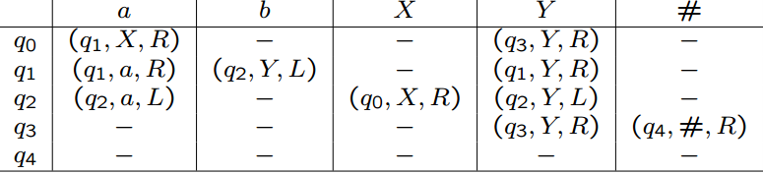
Example 3 Design a Turing Machine that recognize the language w= {a ^{n} b ^{n} : n>=1 }
Turing machine M = ( Q, Γ , Σ , δ, s, B , F) with
Q = {q0, q1, q2, q3, q4 },
Γ = {a, b, X, Y, # }, Σ = {a, b },
s = q0, B = #,
δ given by

Slide 23
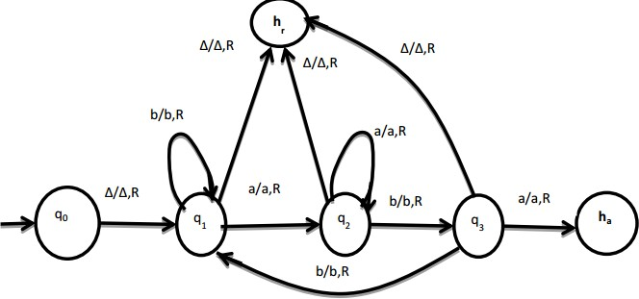
Example: Design a TM accepting {a, b}* (aba)

Slide 24
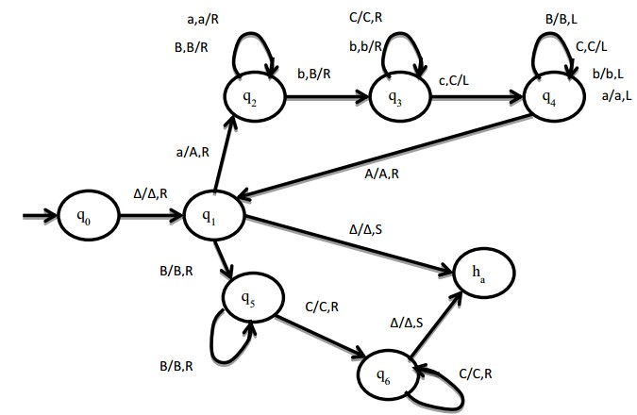

Slide 25
FA , PDA and Turing Machine
Finite Automata:
– Models for devices with finite memory
Pushdown Automata:
– Models for devices with unlimited memory (stack) that is accessible only in Last-In-First-Out order.
Turing Machines (Turing 1936)
Uses unlimited memory as an infinite tape which can be read/written and moved to left or right
  Only model thus far that can model general purpose computers – Church-Turing thesis
  Still, TM cannot solve all problems
Much more powerful than FIFO stack of PDAs.

Slide 26
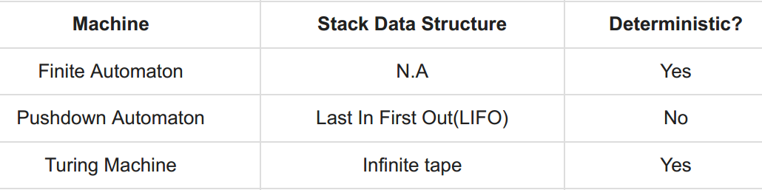
Cont.,

Slide 27
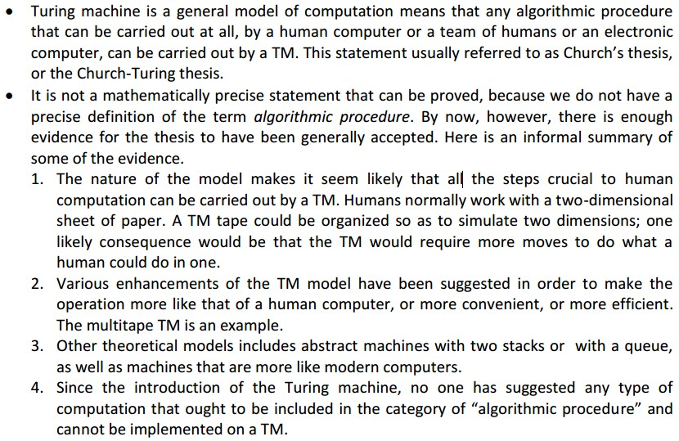
Church-Tuning Thesis

Slide 28
Time and Space Complexity of a Turing Machine
For a Turing machine, the time complexity refers to the measure of the number of times the tape moves when the machine is initialized for some input symbols and the space complexity is the number of cells of the tape written.
Time complexity all reasonable functions −T(n) = O(n log n)
TM's space complexity − S(n) = O(n)

